Slide 1
Welcome! Class will begin at 1:05pm.
Notes:
This class will be recorded, if all consent
I will send out slides, a handout, and a link to the class evaluation after our session
Feel free to post questions in the chat at any time (or unmute yourself)
My email: helenmary@pitt.edu

Slide 2

Preparing for the New NIH Data Management & Sharing Plan (DMSP)
Session 3
Documentation, Metadata, & the “How” of Deposit
Helenmary Sheridan
Data Services Librarian, HSLS
helenmary@pitt.edu

Slide 3
Data Services @ HSLS
HSLS Data Services offers support, consultations, and customized trainings to help you:
Organize your research data before, during, and after collection
Write a data management plan (DMP)
Use electronic research notebooks
Preserve your data for long-term use
Use data effectively
Create effective data visualizations
Locate existing datasets for reuse
Cite datasets accurately
Share your research data
Comply with data sharing policies
Identify appropriate data repositories
Prepare datasets for sharing with documentation and metadata
Increase the reproducibility of your research
Create READMEs, data dictionaries, and code annotations
Manage code with version control
Select licenses for your code and datasets
Adopt principles of open science and join a community of open science practitioners

Slide 4
Topics for this workshop
Quick review of the new NIH data sharing policy
Documentation: READMEs, user manuals, data dictionaries, and codebooks
Metadata: where to find good terms and how to apply them
Licenses and use restrictions
Common Data Elements (CDEs)
Q&A and more demonstrations

Slide 5
Final NIH Policy for Data Management and Sharing
Applies to all research funded to any degree by NIH that results in the generation of scientific data
Does not apply to activities that don’t generate scientific data, like training, infrastructure development, or “non-research activities”
Goes into effect for all applications submitted on or after January 25, 2023, or any activities/agreements executed thereafter
Expects researchers to share as much data as possible while keeping a balance with confidentiality and other sensitive data concerns

Slide 6
Policy FAQ
Q: Can we update our plans once submitted?
A: Yes, subject to NIH ICO approval
Q: Are we really expected to share ALL our non-confidential, non-sensitive data?
A: Yes and no. If you collect a lot of data and throw out half of it as a routine matter, you don’t need to share that junk data. It’s up to your judgment what constitutes “scientific data.” But you do need to share all your meaningful data, even if it’s really, really big or really, really small.
Q: Will this affect Data Use Agreements?
A: Probably not, but you can watch for updates from OSP
Q: Will this affect grants in place prior to January 25, 2023?
A: No, unless you are re-submitting

Slide 7
Policy FAQ
Q: Do people who use shared data have a requirement to share any publications or presentation resulting from their use back to the original investigators? If another person uses the shared datasets in an inappropriate way (manipulates findings) are the original providers of the data responsible in any way?
A: Second question first: no, original data providers are not responsible! (Unless it’s something like PHI that never should have been shared, but Party #2 downloaded it from a public repository and then did something irresponsible with it. Party #1 would bear responsibility for making public what should have stayed private.) First question: it depends. If I use your data and then I publish my research in a journal, that journal will probably require that I cite your data. It would be polite of me to notify you, and that culture is developing, but there’s no enforcement mechanism for that. If I cite your data with a DOI, various online metrics tools will automatically connect our work, so that my research might show up as a “child” of your public dataset. There’s a lot of development around emergent network mapping that’s trying to do exactly that.

Slide 8
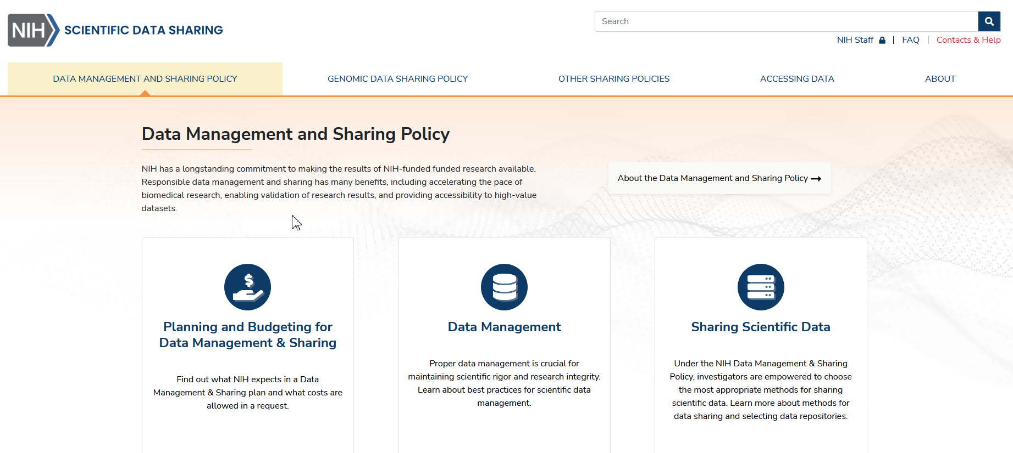
Helpful new NIH Scientific Data Sharing website!
https://sharing.nih.gov/data-management-and-sharing-policy

Slide 9

Documentation

Slide 10
Documentation: Activity
Take a look at the .csv I have provided, US.63650001.csv.
What can you determine about it?
What questions do you have?

Slide 11
Documentation types: the README
READMEs: the equivalent of a hand-written note nailed to the door of your data files
Always a .txt file, so small and basic they can be opened on any computer
Dates back to at least 1974, traditionally included in software downloads
Include the most essential information about your project. What is this? Who made it? Who should someone contact if they have questions? You can get more complex, but always include those

Slide 12
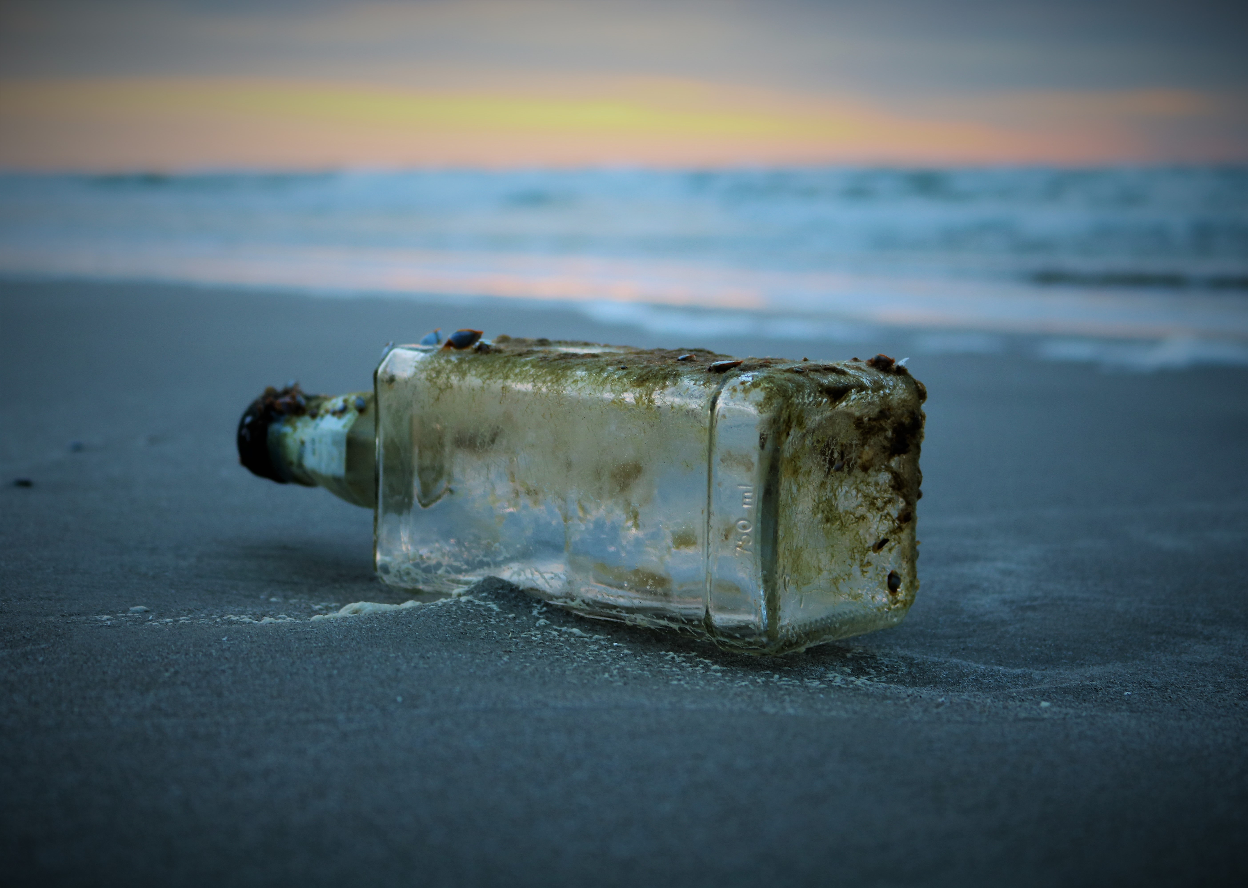
README.txt

Slide 13
Documentation types: the README
README example:
Project Tycho cholera dataset

Slide 14
Documentation types: the codebook
Codebooks describe the contents, structure, and layout of data collection
Frequently used for survey and interview data
Provides details for each variable in the data collection(s), including name, label, the text of a question or prompt, the allowed values, the labels given to each value if non-obvious, the defaults used for missing data, and any additional notes or instructions
ICPSR codebook guide

Slide 15
Documentation types: the codebook
Codebook example:
Duncan, Pamela W., Rosamond, Wayne D., and Bushnell, Cheryl D. Comprehensive Post-Acute Stroke Services (COMPASS) Study, North Carolina, 2016-2018. Inter-university Consortium for Political and Social Research [distributor], 2021-10-07. https://doi.org/10.3886/ICPSR38185.v1

Slide 16
Documentation types: the data dictionary
Data dictionaries are similar to codebooks in concept, but formatted differently
Used for a wide variety of disciplines that collect observational data
Provides details for each variable in the data collection(s), including name, label, the allowed values, the labels given to each value if non-obvious, the defaults used for missing data, and any additional notes or instructions

Slide 17
Documentation types: the data dictionary
Data dictionary example:
NIH All of Us Research Hub
Data Dictionary (maintained on Google Drive)

Slide 18
Documentation types: miscellaneous
Explanations of sample design
Analytic guidelines for using the data
Suggested citations and keywords to use for work reusing the data
Analysis scripts and other supporting code (which could be their own data products too)
Examples of some miscellaneous documentation types: National Health and Nutrition Examination Survey (NHANES)

Slide 19

Metadata

Slide 20
Metadata: data about data
Metadata are little bits of information that describe a file. Metadata allows people and machines to understand the contents of a file, and to perform large-scale analysis on a corpus of files.
Automatically-generated metadata:
the timestamp and possibly geolocation of a photo taken with your phone
author and software version of a Microsoft Word document
User-generated metadata:
all the contributors and their specific roles for an article or dataset
subject keywords associated with a dataset file

Slide 21
Metadata: data about data (2)
Metadata follows schemas and standards, which are validation systems that repositories and other data handlers use to keep metadata both tidy and meaningful.
In most cases, you don’t need to worry about that. The repository will ask for specific pieces of metadata in accordance with the schema/standard they are using.
(If you are building a repository or data platform and want to know about choosing a schema/standard… come talk to me!)

Slide 22
Metadata: data about data (3)
“Good” example of metadata describing a dataset: COMPASS study on ICPSR
“Bad” example of metadata describing a dataset: A cross-sectional study of nemaline myopathy supplementary figures, DRYAD Data Repository
Example of subject keywords used for browsing in Dryad: Browse by subject area

Slide 23
Metadata: data about data (4)
Recommendations for making your metadata useful:
Provide as many keywords as you can (3 is a good number)
Use keywords taken from a controlled vocabulary like the National Library of Medicine’s Medical Subject Headings (MeSH)
NCBI Taxonomy is great for organisms
Sign up for an ORCiD ID to establish your unique author ID, and provide that for every publication and shared resource

Slide 24
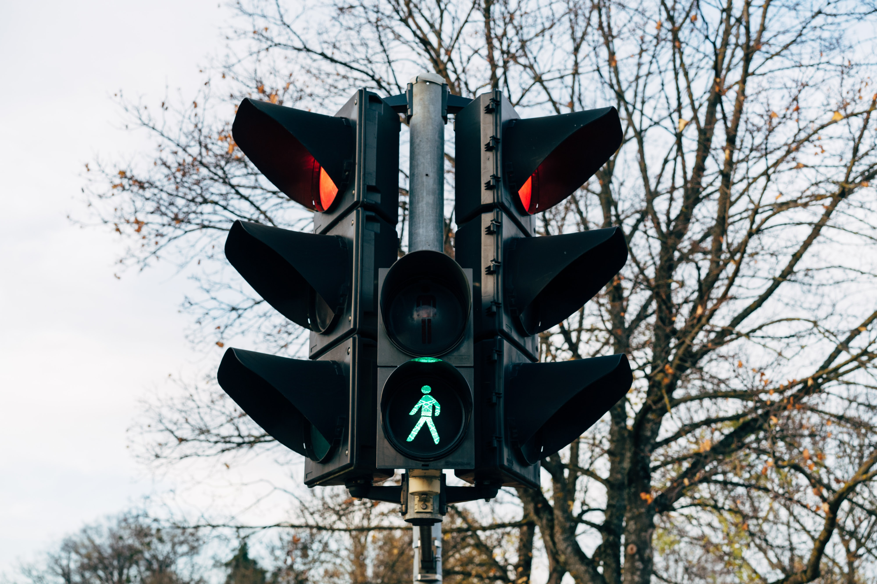
Licenses and Use Restrictions

Slide 25
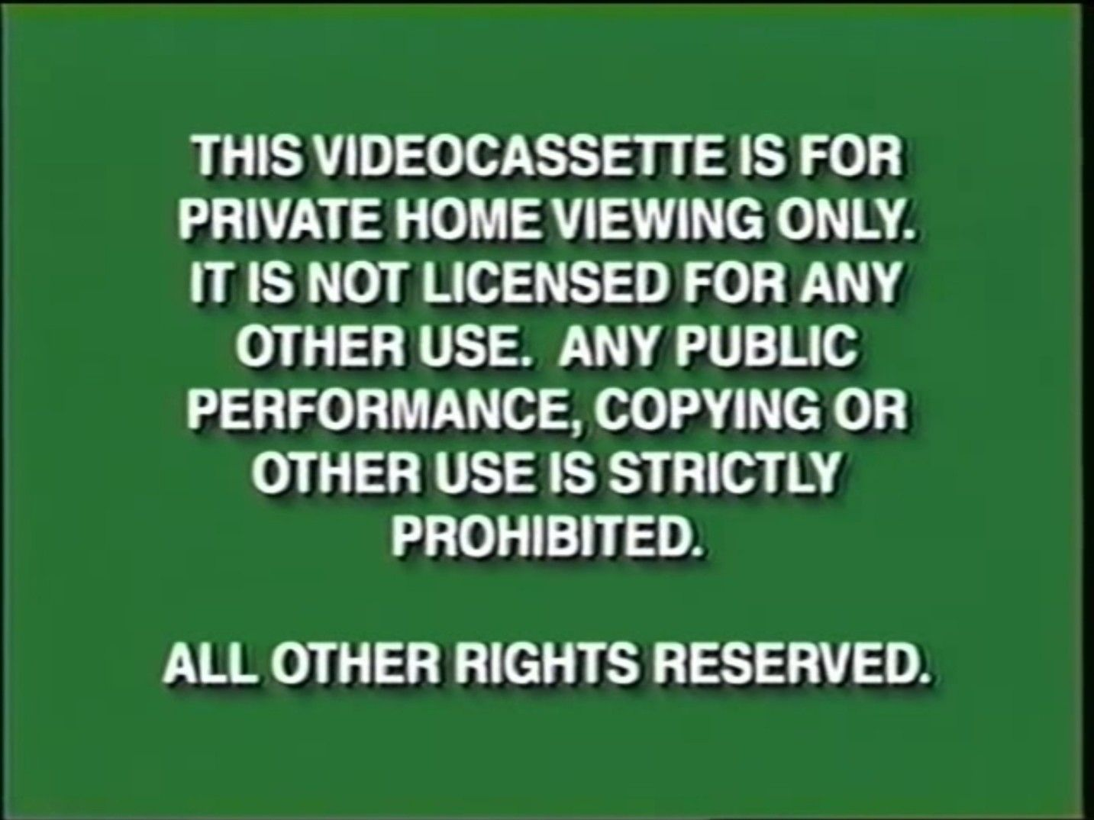
Licenses and Use Restrictions
A license is a piece of text that tells users of a file what they are allowed to do with it.
Image at right: the FBI warning screen that showed on US home videos from 1997-2000

Slide 26
Licenses and Use Restrictions (2)
In the US, having no license on a work is the same thing as stating “all rights reserved.”
“All rights reserved” has been interpreted as meaning that a user cannot:
Email a copy of a PDF to themselves to read on another computer
Reproduce any amount of text for any reason whatsoever (in a review, for example, or just to share a favorite line)
Make a copy for archival/preservation purposes, if the organization that bought the original copy is a library

Slide 27
Licenses and Use Restrictions (3)
Because one main purpose of sharing data is to increase data reuse, many data repositories apply a Creative Commons Zero (CC0) waiver to all files that are uploaded.
CC0: “No Rights Reserved”
Removes copyright, but most data is not copyrightable anyway

Slide 28
Licenses and Use Restrictions (3)
From the Dryad FAQ (“Why does Dryad use CC0?”)
“Importantly, CC0 does not exempt those who reuse the data from following community norms for scholarly communication. It does not exempt researchers from reusing the data in a way that is mindful of its limitations. Nor does it exempt researchers from the obligation of citing the original data authors. However, like other scientific norms, these expectations are best articulated and enforced by the community itself through processes such as peer review.”

